Slide 1
APRS STUDENT MISSION – Weekly meeting
JAVIER FERRER TA PHUONG LINH
Date: 2023/04/26
Meeting: In-person meeting
Time: 14:40 – hh:mm JST

Slide 2
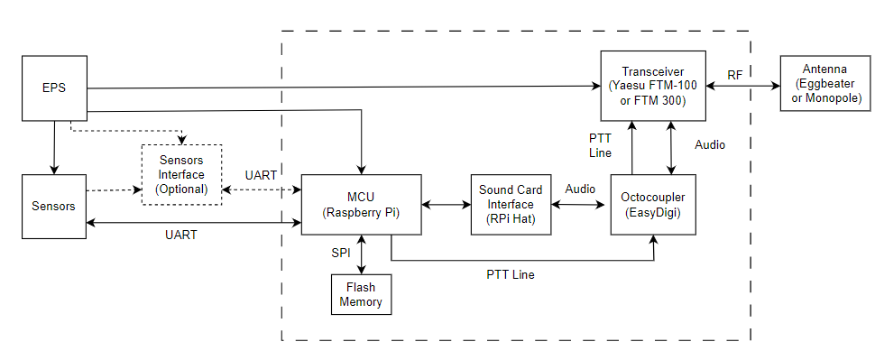
Component block diagram (tentative)
Ref components:
MCU
Sound card
Interface card (octocoupler)
Radio transceiver
Antennas
- Eggbeater
- Monopole
- ¼ wave ground plane monopole

Slide 3
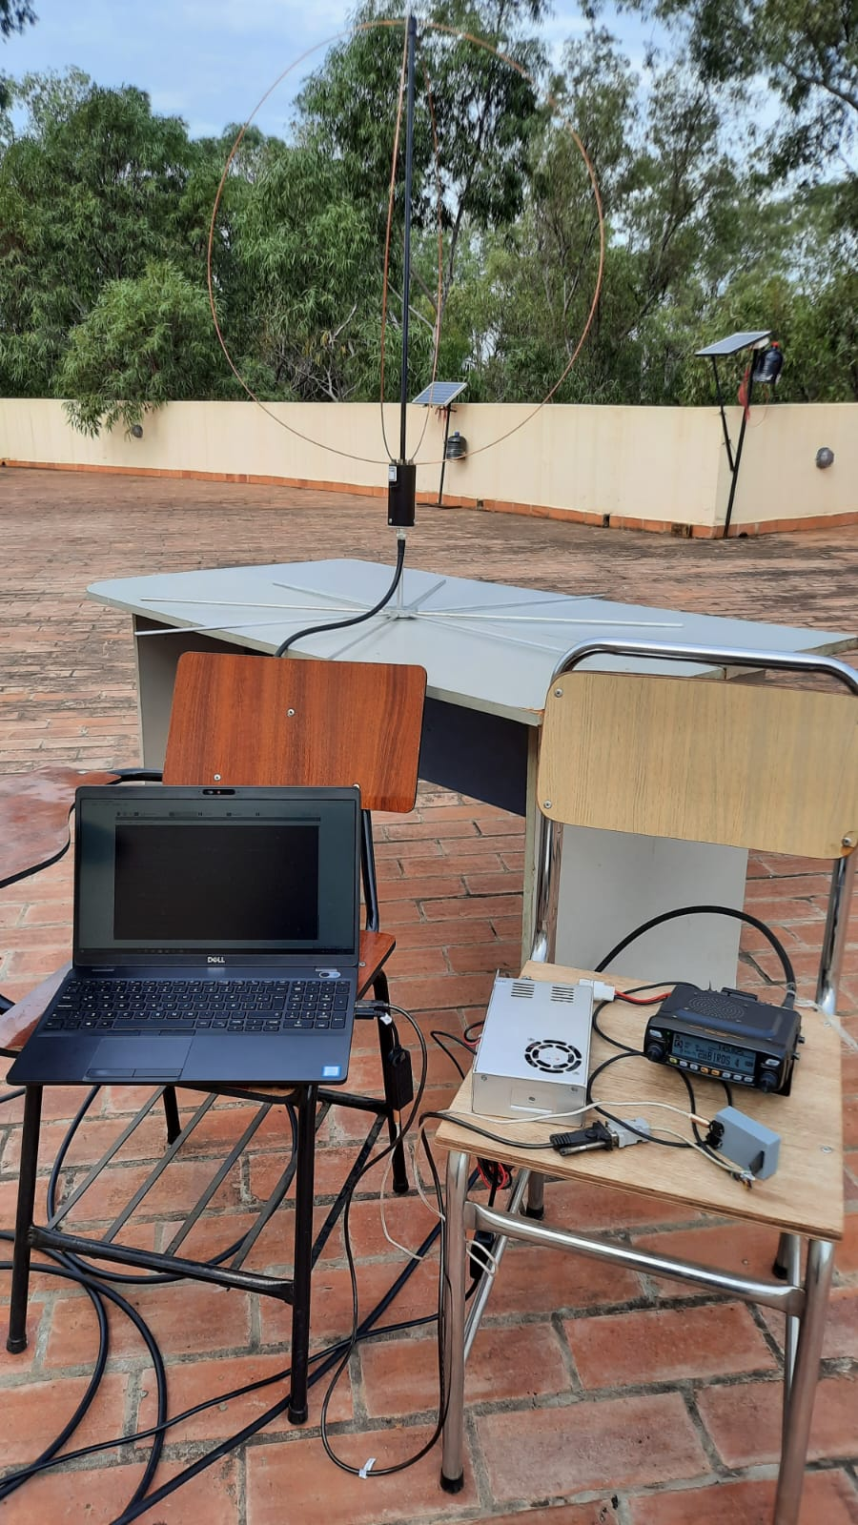
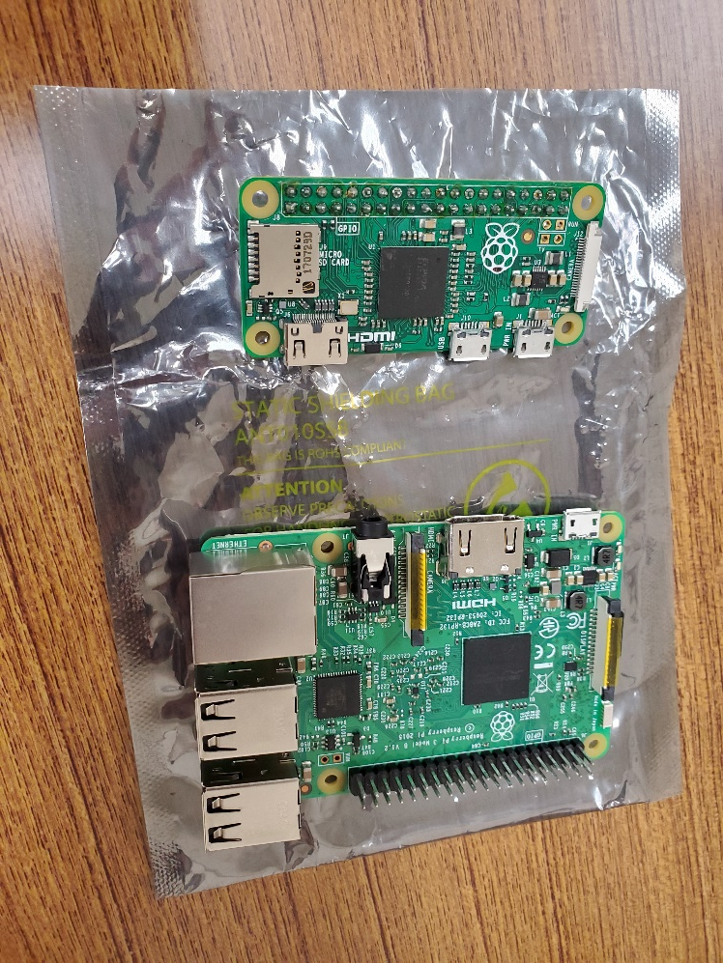
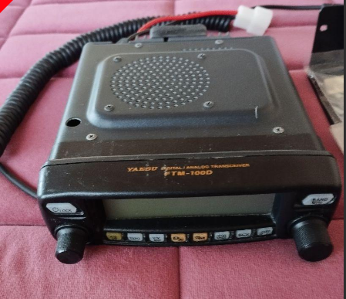
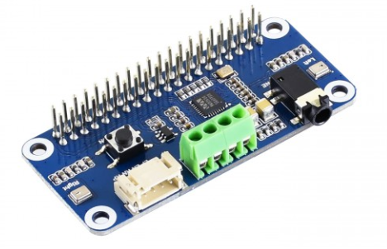
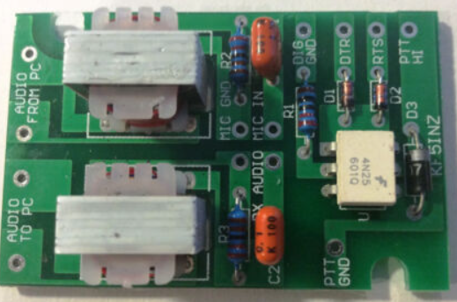
Eggbeater antenna
Yaesu FTM 100-DH
Radio transceiver
Raspberry Pi Zero (top)
and Pi 3 B (bottom)
Easy DIGI Interface Card
WM8960 Hi-Fi Sound Card HAT

Slide 4
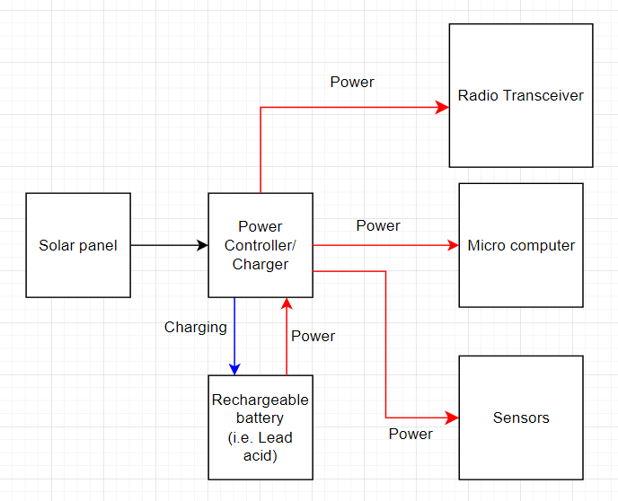
EPS block diagram (tentative)
Notes:
For the system power supply, we can use a Solar panel, which connects with a Rechargeable battery by a power charger/ controller circuit.
It is probably that the Sensors Interface block needs it own battery which does not relate to the Rechargeable battery

Slide 5
Sensors that we are currently considering (based on type of data):
Air vibration:
INFRASONIC SENSOR TYPE7744N (ACO CO., LTD)
MB3a (SEISMO WAVE)
Gas sensor:
RKI ES-1827I Replacement Sensor (PREMIERSAFETY)
KHS-5P (Komyo Rikagaku Kogyo)
Ash sensor:
Parsivel2 (OTT)

Slide 6
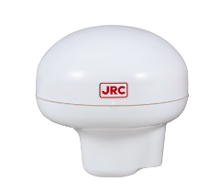
Sensors that should be added (based on type of data):
Ground deformation (using ground-based monitoring approach):
Using GPS data of our RF Transceiver
Using GPS sensors
JLR-4350 (JRC)
Key specifications:
Accuracy: 5m (GPS); 4m (when combining GPS with other positioning systems)
Sensitivity: < -144 dBm
Position update: every 1 sec (normally)
Mass: Approx. 1.2 kg
Operating temperature: -25 ℃ to +55 ℃
Notes:
Reason:
- Ground deformation occurs due to the movement of magma and other fluids in the subsurface before, throughout, and after an eruption (USGS). Thus, it ‘s very important to know this data for volcano monitoring

Slide 7
On-going activities

Slide 8
Volcano monitoring
VHF Omni Antenna
Candidates:
1. Eggbeater
2. Monopole antenna
Radio transceiver
(YAESU FTM-100DH)
Sensors
(types of sensors)
Sensor interface board
(optional)
Interface card
(Easy digi)
Microcomputer
(Raspberry Pi 3)
External sound card
(WM8960)
Another option
SOLAR PANEL
Battery (Lead acid)
Power recharge/ controller
Power distribution circuit

Slide 9
Other antenna candidates
Other Monopoles
- Shakespear HA156c
- Diamond SG-7900 144/430MHz VHF UHF

